Slide 1
Data Structures II Graphs & Trees
Madamanchi SI 507 Fall 2022

Slide 2
Learning Objectives
Data Structures II
L: Representing trees (e.g., Binary Search Trees)
L: Representing graphs (directed/undirected, weighted/unweighted)
Algorithms II
L: Tree search:
depth first
breadth first
BST search
L: Graph traversal
shortest path
connected components
L: Able to compare complexity (linear search vs binary search), introduction of Big-O notation
L: Use profiling techniques/tools to compare algorithm efficiency

Slide 3
So far we’ve covered LINEAR data structures
Built-in
list
set
dictionary
tuple
User-Defined
Stack
Queue

Slide 4
Identify the Stack vs Queue
FIFO vs LIFO
Gif Source: https://thagomizer.com/blog/2016/05/06/algorithms-queues-and-stacks.html Note - code at source is not in python

Slide 5
Non-linear Data Structures
Trees | Graphs
Minimally connected | Multiple paths
Less Complex | More complex
Has a root node | --
Hierarchical | Network
Can’t have loops/cycles/circuits | Can have loops/cycles/circuits
All are directed | Can be directed or undirected
Graphs & Trees

Slide 6
Visual representation is somewhat arbitrary

Slide 7


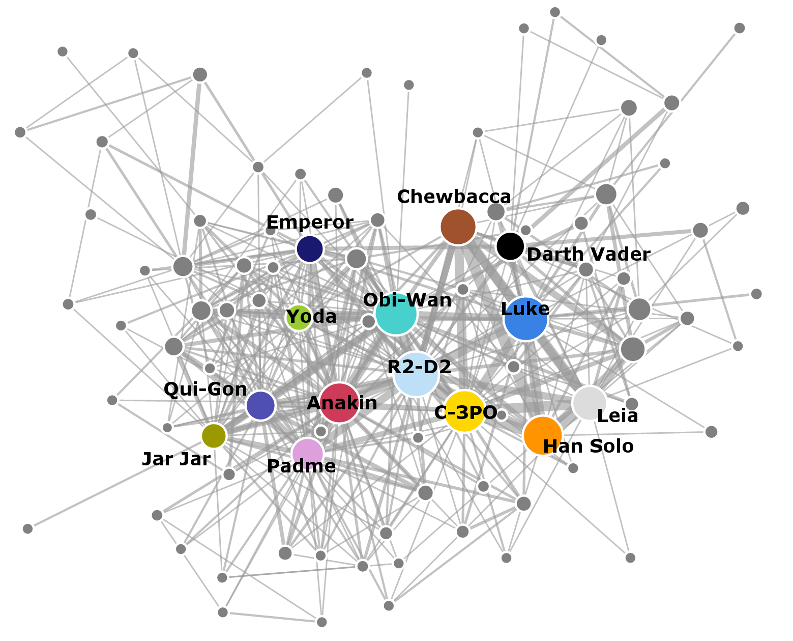

Applications of Graphs
Trees | Graphs
Minimally connected | Multiple paths
Less Complex | More complex
Has a root node | --
Hierarchical | Network
Can’t have loops/cycles/circuits | Can have loops/cycles/circuits
All are directed | Can be directed or undirected
Trees
Graphs
Minimally connected
Multiple paths
Less Complex
More complex
Has a root node
--
Hierarchical
Network
Can’t have loops/cycles/circuits
Can have loops/cycles/circuits
All are directed
Can be directed or undirected

Slide 8
Graphs - Formal Definitions
A graph is a data structure made up of a set of vertices connected by edges
A vertex can have any number of edges
An edge can be bidirectional or directed i.e. one way
An edge can be weighted
Weight indicates a cost of going down an edge
A path is a route, consisting of edges and vertices, between two vertices

Slide 9
Representing Graphs with Code - Adjacency Matrix
Only really makes sense for weighted graphs
1
 | V1 | V2 | V3 | V4 | V5
V1 | 0 | 1 | 4 | 0 | 0
V2 | 1 | 0 | 6 | 7 | 0
V3 | 4 | 6 | 0 | 3 | 0
V4 | 0 | 7 | 3 | 0 | 1
V5 | 0 | 0 | 0 | 1 | 0
1
2
4
6
7
3
4
1
5
3
AdjMatrix = [[0,1,4,0,0], # list of edges from V1
[1,0,6,7,0], # list of edges from V2
[4,6,0,3,0], # list of edges from V3
[0,7,3,0,1], # list of edges from V4
[0,0,0,1,0]] # list of edges from V5
AdjMatrix[2][3]
Notes:
First row is 0,1,4,0,0
The advantage of the adjacency matrix is that it is simple, and for small graphs it is easy to see which nodes are connected to other nodes. However, notice that most of the cells in the matrix are empty. Because most of the cells are empty we say that this matrix is “sparse.” A matrix is not a very efficient way to store sparse data. In fact, in Python you must go out of your way to even create a matrix structure like the one.
The adjacency matrix is a good implementation for a graph when the number of edges is large. But what do we mean by large? How many edges would be needed to fill the matrix? Since there is one row and one column for every vertex in the graph, the number of edges required to fill the matrix is |V|2 . A matrix is full when every vertex is connected to every other vertex. There are few real problems that approach this sort of connectivity. Most graphs are relatively sparse.

Slide 10
Representing Graphs with Code - Adjacency List
Only really makes sense for weighted graphs
1
 | Dictionary
“V1” | [V3,4][V2,1]
“V2” | [V3,6][V4,7][V1,1]
“V3” | [V2,6][V1,4][V4,3]
“V4” | [V3,3][V2,7][V5,1]
“V5” | [V4,1]
1
2
4
6
7
3
4
1
5
3
AdjList = [VertexObject, #dictionary of edges from V1
VertexObject, # dictionary of edges from V2
VertexObject, # dictionary of edges from V3
VertexObject, # dictionary of edges from V4
VertexObject] # dictionary of edges from V5
“V1”: {“V2”:1, “V3”:4}
“V2”: {“V3”:6, “V4”:7, “V1”:1}
“V3”: {“V2”:6, “V1”:4, “V4”:3}
“V4”: {“V3”:3, “V2”:7, “V5”:1} “V5”: {“V4”:1}
Notes:
V1: {V2:1, V3:4}
V2: {V3:6, V4:7, V1:1}
V3: {V

Slide 11
Graphs in Python - tinyURL.com/w6si507
Implement a class called Vertex with attributes id and connectedTo
connectedTo should create an empty dictionary
What input arguments do you need for this class?
Add a method called addNeighbor which adds a connection to another vertex
addNeighbor should work by updating connectedTo to include an id and weight.
Note, because id is an attribute of this vertex use a different variable name - nbr - to update connectedTo
Add a method called getId that returns this vertex objects id
Add a method called getConnections that returns all the nbrs
Add a method called __str__ that returns a string that tells you the id of the vertex object and all the vertex and weight its connected to
Add a method called getWeight that returns the weight to a given nbr
class Vertex:
def __init__(self, key):
self.id = key
self.connectedTo = {}
def addNeighbor(self, nbr, weight=0):
self.connectedTo[nbr] = weight
def getId(self):
return self.id
def getWeight(self, nbr):
return self.connectedTo[nbr]
def getConnections(self):
return self.connectedTo.keys()
def __str__(self):
#return str(self.id) + ‘is connected to ‘ + str([(x.id, x.weight) for x in self.connectedTo])

Slide 12
Graphs in Python - tinyURL.com/w6si507
Implement a Class called Graph with attributes vertList and numVertices
vertList should create an empty dictionary
numVertices should start out with what what value?
What input arguments do you need for this class?
Add a method called addVertex which does what it sounds like
How should this method interact with the attributes of Graph?
What input arguments are needed for this method?
Please return the vertex object that is created
Add a method called getVertex that returns a specific vertex object
What input argument is needed?
How should this method handle it if the requested vertex object is not present?
Add a method called getVertices that returns all ____
Add a method called __contains__ that returns all the vertices of the graph
Add a method called addEdge that uses the addNeighbor method from the Class Vertex to add a weight between two vertices
What input arguments are needed?
Make this method add vertex objects to the graph if they are not already present so that an error won’t be thrown
Add the following method and try to figure out what it means
def __iter__(self):
return iter(self.vertList.values())
Test your implementation with the following code
g = Graph()
for i in range(5):
g.addVertex(i)
g.vertList
g.addEdge(0,1,5)
g.addEdge(0,5,2)
g.addEdge(1,2,4)
g.addEdge(2,3,9)
g.addEdge(3,4,7)
g.addEdge(3,5,3)
g.addEdge(4,0,1)
g.addEdge(5,4,8)
g.addEdge(5,2,1)
for v in g:
for w in v.getConnections():
print("( %s , %s )" % (v.getId(), w.getId()))
Notes:
https://colab.research.google.com/drive/1lQ2sI4ugqJ6-kaHxWl0Md0OwVwcCCWYu?usp=sharing

Slide 13
Whats with the __methods__
These are called magic methods or dunder methods
These are built-in to python classes - they have dunders so you don’t accidentally overwrite them
We are overwriting them on purpose.
Reading: https://github.com/RafeKettler/magicmethods/blob/master/magicmethods.pdf

Slide 14

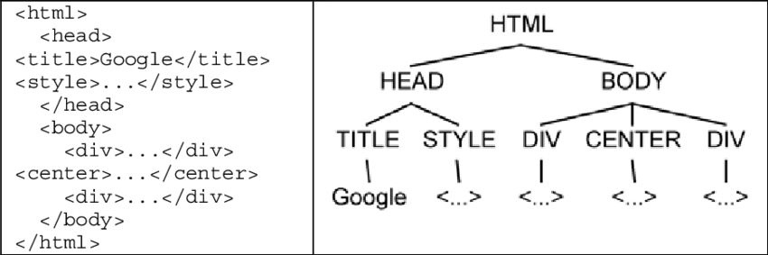

Applications of Trees
Hierarchical file systems
html code
linguistic/evolutionary relationships
Note trees and graphs are both just abstractions of real relationships
Notes:
Cenys, Antanas & Grigalis, Tomas. (2014). Unsupervised Structured Data Extraction from Template-generated Web Pages. JOURNAL OF UNIVERSAL COMPUTER SCIENCE. 20.

Slide 15
Tree - Formal Definitions
A Tree is a data structure made up of a set of nodes connected by edges
A node can have any number of edges
An edge connects two nodes
Each node has one incoming edge
Each node can have zero or more outgoing
A path is a route, consisting of edges and nodes
A Parent node is a node with outgoing edges
Children are nodes that have incoming edges from a parent
Siblings are child nodes with the same parent
Leaf node is a node with no children
Root node is the parent of all nodes
Level is the number of edges between a node and its root.
The Root node is level 0
The Height of a tree is the max level of any node

Slide 16
Representing Trees in Python
This tree can be thought of as a set of python objects with defined attributes
a
A
Implement a Class called Node with attributes val, left, and right
What input arguments do you need for this class?
Add a method called insert_left
If there is no current child node on the left, add a child node to the left of the current node
If there is a current child node on the left, push it down and add a new one.
Also create a method called insert_right that does the same
L
R
b
c
B
C
f
L
R
L
R
d
e
D
E
F
L
R
L
R
L
R
Notes:
Note this only works ‘binary trees’ but if you wanted to do a non-binary tree just replace the left and right attributes with a single attribute called children.

Slide 17
Representing Trees in Python
tree = [
'a', #root
[
'b', # left subtree
['d', [], []],
['e', [], []]
],
[
'c', # right subtree
['f', [], []],
[]
]
]
This tree can be thought of as a set of python objects with defined attributes
Create an instance of class Node called root with value ‘a’
Use the methods we have created to add B, C, D, E, F
You could also represent this with a nested list or a nested dictionary
Give this a try
What are some advantages and disadvantages?
A
L
R
B
C
L
R
L
R
D
E
F
L
R
L
R
L
R
Notes:
Note this only works ‘binary trees’ but if you wanted to do a non-binary tree just replace the left and right attributes with a single attribute called children.

Slide 18
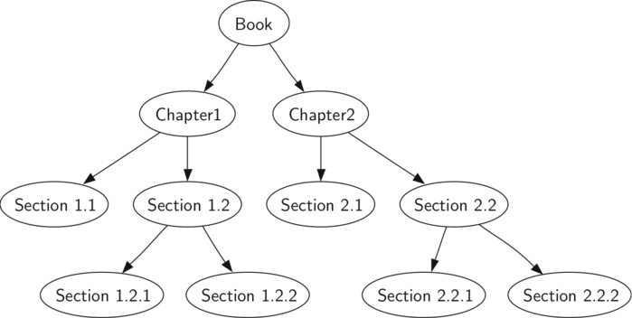
Tree Traversal
A main use of trees is to access all the nodes.
The order in which you do that has major implications for efficiency
preorder - visit the root first, and then recursively traverse the left subtree, and then the right subtree
inorder - recursively traverse the left subtree, visit the root, and then the right subtree
postorder - recursively traverse the left subtree, and then right subtree, and finally visit the root
Code for preorder | Code for postorder | Code for inorder
def preorder(node): if node: print(node['val']) preorder(node.get('left')) preorder(node.get('right')) | def postorder(node): if node: postorder(node.get('left')) postorder(node.get('right')) print(node['val']) | def inorder(node): if node: inorder(node.get('left')) print(node['val']) inorder(node.get('right'))

Slide 19
Map ADT (abstract data type)
map() Create a new, empty map.
put(key, val) Add a new key-value pair to the map. If the key is already in the map then replace the old value with the new value.
get(key) Given a key, return the value stored in the map or None otherwise.
del Delete the key-value pair from the map using a statement of the form del map[key].
len() Return the number of key-value pairs stored in the map.
in Return True for a statement of the form key in map, if the given key is in the map.
Does this remind you of any prior structure?
We can use Map() to implement Binary Search Trees

Slide 20
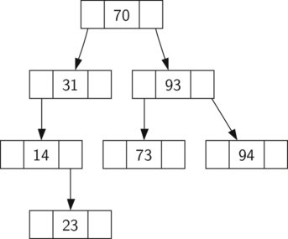
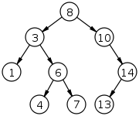
Binary Search Tree (BST)
A type of binary tree in which the values of each left subtree are by definition lower than the right subtree
Which of these is not a BST
6
2
8
1
4
9
3
7

Slide 21
BST in python
Implement a class called BinarySearchTree with attributes root and size
Use a default value of None for root
What is the default value of size?
Add methods length and and __len__ both of which return size
Add the method __iter__ which returns self.root.__iter__()
What is the purpose of this?
BinarySearchTree will contain objects of class TreeNode
Starter code provided in the first cell here: https://colab.research.google.com/drive/1WxsU10GeCpiotTUtIGABdGsGfzTZJEbl?usp=sharing
Annotate to your understanding

Slide 22
put method for Binary Search Tree
This method will check to see if the tree already has a root. If there is not a root then put will create a new TreeNode and install it as the root of the tree. If a root node is already in place then put calls the private, recursive, helper function _put to search the tree according to the following algorithm:
Starting at the root, search the binary tree comparing the new key to the key in the current node.
If the new key < current node, search the left subtree.
If the new key > current node, search the right subtree.
When there is no left (or right) child to search, we have found where the new node should be installed
To add a node to the tree, create a new TreeNode object and insert at the point in the previous step.
Fill in starter code, and then update magic method setitem to call put
def put(self,key,val):
if self.root:
self._put(key,val, self.root)
else:
Self.root = TreeNode(key,val)
self.size = self.size + 1
def _put(self,key,val,currentNode):
if key < currentNode.key:
if currentNode.hasLeftChild():
self._put(key,val,currentNode.leftChild)
else:
currentNode.leftChild = TreeNode(key,val,parent=currentNode)
else:
if currentNode.hasRightChild():
self._put(key,val,currentNode.rightChild)
else:
currentNode.rightChild = TreeNode(key,val,parent=currentNode)
Notes:
One important problem with our implementation of insert is that duplicate keys are not handled properly. As our tree is implemented a duplicate key will create a new node with the same key value in the right subtree of the node having the original key. The result of this is that the node with the new key will never be found during a search. A better way to handle the insertion of a duplicate key is for the value associated with the new key to replace the old value. We leave fixing this bug as an exercise for you.

Slide 23
get method for Binary Search Tree
This method will return the value for a given key
_get is a helper method to do ____
Whats the point of __getitem__ if all it does is call get?
def get(self,key):
if self.root:
res = self._get(key,self.root)
if res:
return res.payload
else:
return None
else:
return None
def _get(self,key,currentNode):
if not currentNode:
return None
elif currentNode.key == key:
return currentNode
elif key < currentNode.key:
return self._get(key,currentNode.leftChild)
else:
return self._get(key,currentNode.rightChild)
def __getitem__(self,key):
return self.get(key)
Notes:
One important problem with our implementation of insert is that duplicate keys are not handled properly. As our tree is implemented a duplicate key will create a new node with the same key value in the right subtree of the node having the original key. The result of this is that the node with the new key will never be found during a search. A better way to handle the insertion of a duplicate key is for the value associated with the new key to replace the old value. We leave fixing this bug as an exercise for you.

